Slide 1
Cold Crime: winter crime analysis in the city of Houston
Group Members: Ozkar Agoz, Melissa Agruda, David Ayankoya, Douglas NcNeil

Slide 2
Motivation and summary
Main Hypothesis: Weather changes may possibly affect the number of crimes
Questions
What times did most crimes occur in the winter of 2018-2019?
Do crime patterns change around the holidays?

Slide 3
Motivation and summary
crime data in Houston - narrowed down to one season and to look at hourly data.
Since most holidays occurred in winter, holiday dates as points of interest.
Hundreds of crimes- chose Driving under the influence (dui) as the main crime to analyze.
Chose burglary as a secondary crime to analyze
Compare trends in Stock market using dow jones api vs burglaries
We were not completely able to answer some of our questions to our satisfaction.
Dui data was not available for the 4 years prior to 2018.
Historical hourly Weather api was not available

Slide 4
Data cleanup and exploration
November 2018, December 2018 and January 2019 were initially chosen as our data sets.
We mainly used crime data from https://www.houstontx.gov/police/cs/crime-stats-archives.htm
Hpd website only had these in excel format with several titles and headers that required extensive cleanup and conversion to csv
The 3 files were concatenated before analysis
Concatenated an additional 4 years for a more robust data set
We wanted to use Open weather api to correlate to any findings we may have
https://openweathermap.org

Slide 5
2018-2019 dui for thanksgiving, Christmas, new year’s day and 3 month average
2014-2019
burglaries for thanksgiving, Christmas, new year’s day and total average

Slide 6
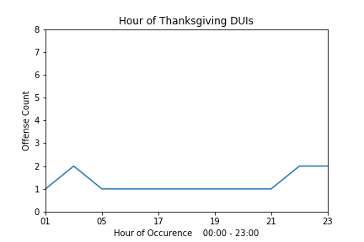
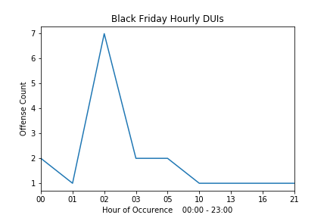
ThanksGiving DUI
Notes:
Thanksgiving fairly consistent and low for rates of DUI across the hours; during Black Friday we see a spike in

Slide 7
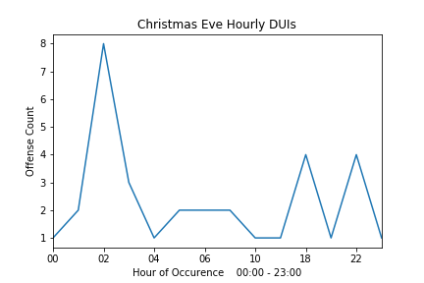
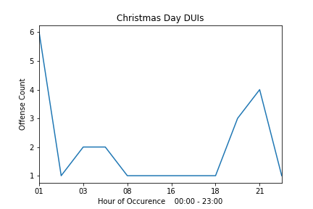
Christmas DUI

Slide 8
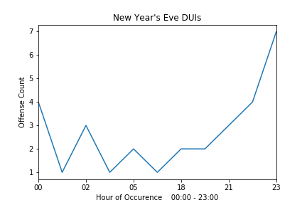
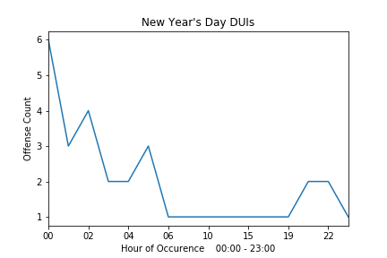
New Year’s dui

Slide 9
5 year comparison of burglaries over hours

Slide 10

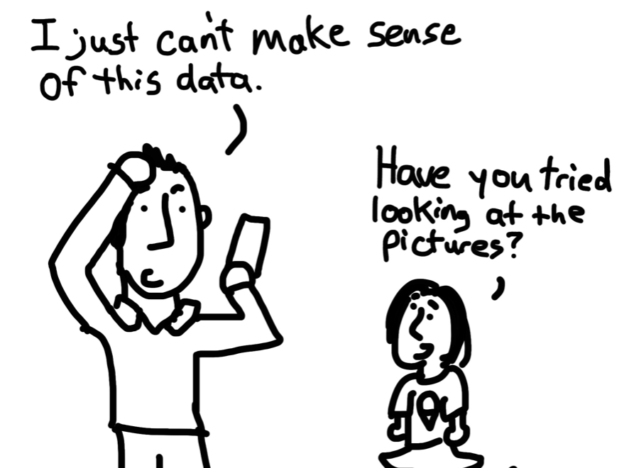
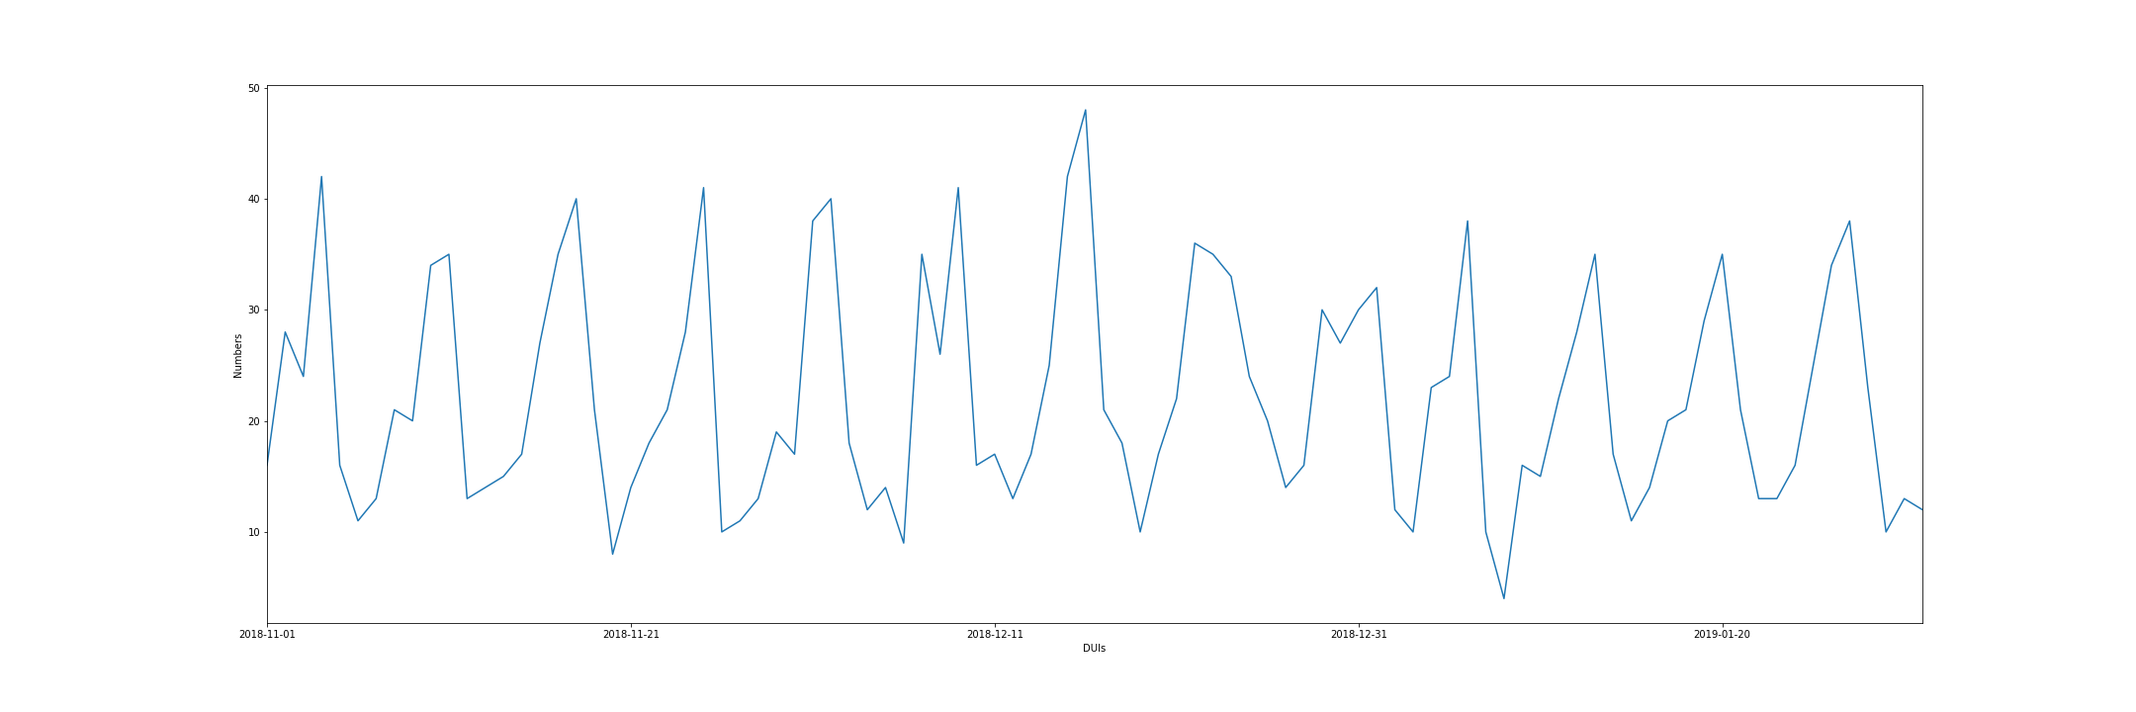
Possible Reasons for Increased Trend of Crimes
Trying to make sense

Slide 11
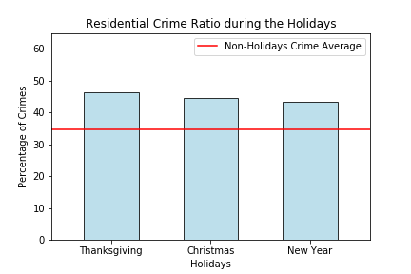
Increased Trend of Property Crimes During Holidays

Slide 12
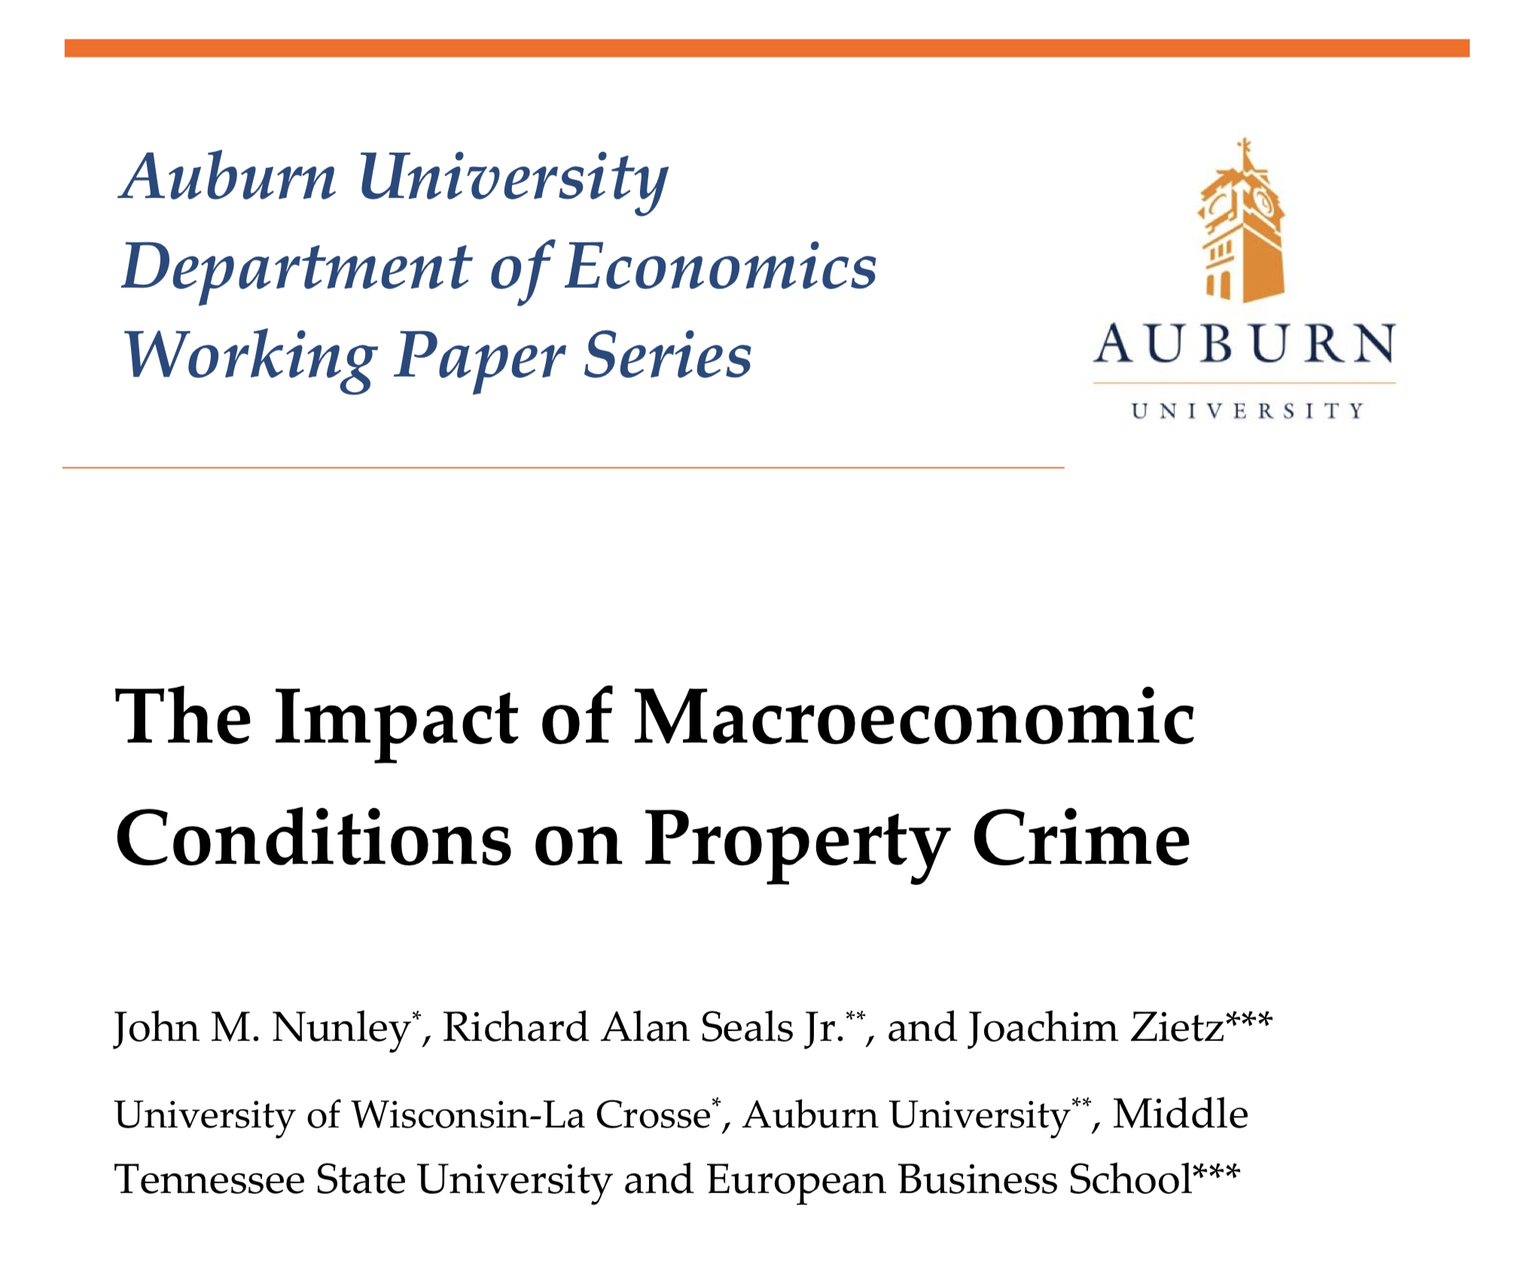
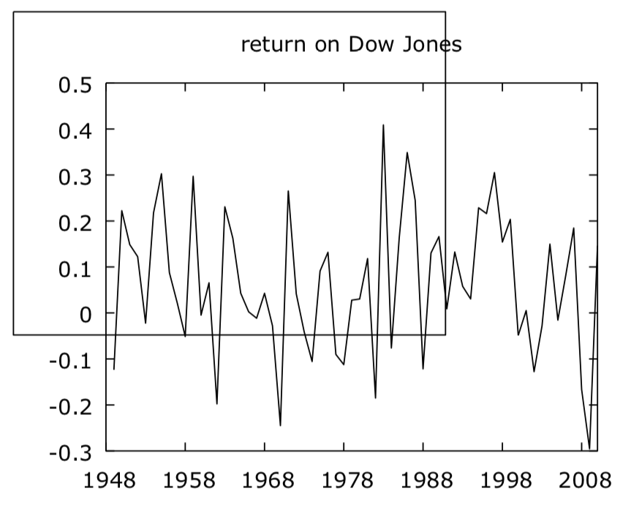

Slide 13
Impact of Macroeconomic Conditions on Crime
Literature: Macroeconomic variables had significant impact on crime
Phase 1: Dow Jones stock market index
Phase 2: Inflation rate
Phase 3: Unemployment rate

Slide 14


Impact of Macroeconomic Conditions on Crime
Literature: Macroeconomic variables had significant impact on crime
Phase 1: Dow Jones stock market index
Phase 2: Inflation rate
Phase 3: Unemployment rate
API

Slide 15
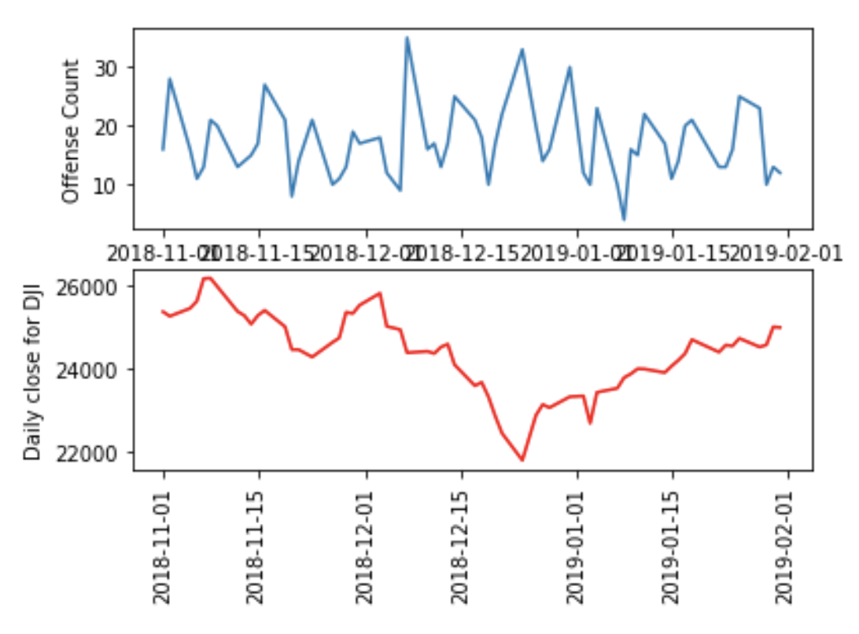
Impact of Macroeconomic Conditions on Crime
Literature: Macroeconomic variables had significant impact on crime
Phase 1: Dow Jones stock market index

Slide 16
Premise: residence

Slide 17
Pie chart % Dui to all crimes in Houston from nov. 1, 2018 to Jan 31, 2019

Slide 19
Correlation of the dow jones market to property crime
Source: http://media.cla.auburn.edu/economics/workingpapers/
http://econpapers.repec.org/paper/abnwpaper/

Slide 20
discussion
Discuss your findings. Did you find what you expected to find? If not, why not? What inferences or general conclusions can you draw from your analysis?

Slide 21
Port mortem
Discuss any difficulties that arose, and how you dealt with them
Discuss any additional questions that came up, but which you didn't have time to answer: What would you research next, if you had two more weeks?

